Slide 1
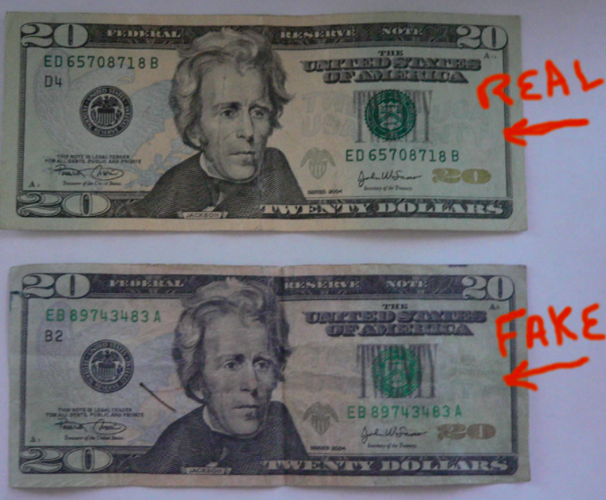
DIGITAL IMAGE PROCESSING FOR COUNTERFEIT NOTE DETECTION
Guidance by: Prof. John Kim
By:Pallavi Dixit , Id: 92844

Slide 2

Agenda
Introduction
Abstract Of project
Part 1 ( Strip Comparison)
Part 2 ( Edge detection)
Part 3 (Feature detection)
Conclusion

Slide 3
INTRODUCTION
Fake currency is imitation currency produced without the legal sanction of the state or government. Producing or using fake currency is a form of fraud or forgery. Counterfeiting is almost as old as money itself.
Before the introduction of paper money, the most prevalent method of counterfeiting involved mixing base metals with pure gold or silver. A form of counterfeiting is the production of documents by legitimate printers in response to fraudulent instructions.
Some of the ill-effects that counterfeit money has on society include a reduction in the value of real money and increase in prices due to more money getting loss, when traders are not reimbursed for counterfeit money detected by banks, even if it is confiscated.

Slide 4
Digital image processing is the use of computer algorithms to perform image processing on digital images. As a subcategory or field of digital signal processing, digital image processing has many advantages over analog image processing.
It allows a much wider range of algorithms to be applied to the input data and can avoid problems such as the build-up of noise and signal distortion during processing. Since images are defined over two dimensions (perhaps more) digital image processing may be modeled in the form of multidimensional systems.
Digital image processing allows the use of much more complex algorithms, and hence, can offer both more sophisticated performance at simple tasks, and the implementation of methods which would be impossible by analog means.

Slide 5
ABSTRACT
In this project we are using “Digital Image Processing” tools and techniques to differentiate between the real and counterfeit currency of US dollar. This project is mainly divided into three parts.
PART-1 PART-2 PART-3
STRIP COMPARISON EDGE DETECTION FEATURE DETECTION

Slide 6
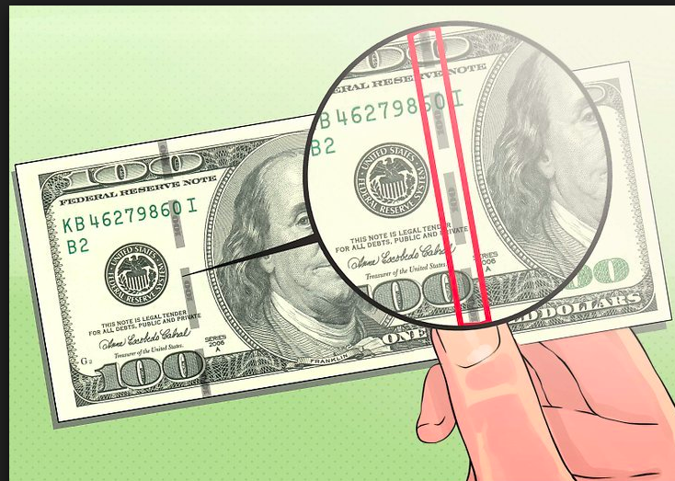
PART-1 (STRIP COMPARISON)
The International Bank Note Society, or IBNS, says the Bank of England issued the first metal-strip currency in 1948. When held up to the light, the strip left a black line visible in the note. In theory, if criminals managed to alter or duplicate the face of the note, they still couldn't copy the metal threads. However, counterfeiters simply drew a black line in the same place, and most people were fooled

Slide 7
*A line on the bill lights up under U-V rays. The position of the line varies with each denomination. Counterfeit-detector scanners can alert users if the bill lacks the magnetic ink used in printing real money.
*Real bills have tiny microprinting on them at various points, visible under magnifying glass. Counterfeiters can beat these seemingly foolproof methods, even using inkjet printers and copiers.
*This may be getting easier, because as paying with plastic becomes more common, fewer people see paper money regularly. On top of that, the government's frequent redesigns of money may leave consumers less sure what an official bill should look like.

Slide 8
CODE FOR STRIP COMPARISON
% //Read in images
clear all;
close all;
% Reding images from project folder
[Ireal,Ifake,Ifake2] = readImages();
%Extract strip from notes from coloum 195 to 215 which has strip.
[blackStripReal, blackStripFake,blackStripFake2] = extractStripsOfImages(Ireal,Ifake,Ifake2);

Slide 9
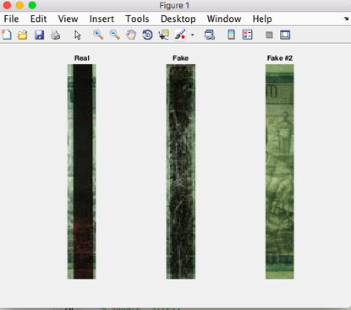
EXTRACTING STRIP FROM THE NOTES
%Convert RGB to Gray for all images (real,fake1,fake2)[blackStripReal, blackStripFake,blackStripFake2] = convertRgbToGray(blackStripReal, blackStripFake,blackStripFake2);

Slide 10
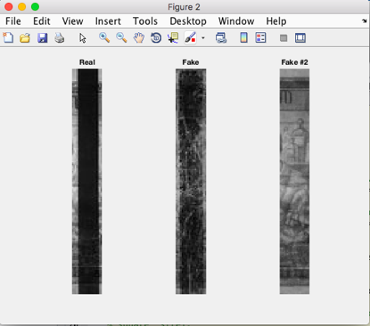
Conversion rgb2gray scale

Slide 11
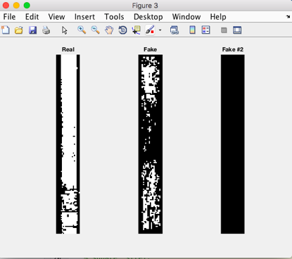
%Performing threshold operation intensity 30
blackStripRealBW, blackStripFakeBW,blackStripFake2BW] = imagesWithIntensity(blackStripReal, blackStripFake,blackStripFake2);
Applying threshold value

Slide 12
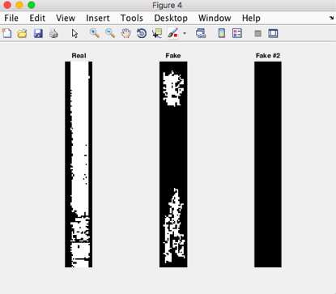
%Remove connected components from images
[areaopenReal, areaopenFake, areaopenFake2] = removeConnectedComponents(blackStripRealBW, blackStripFakeBW, blackStripFake2BW);
Clarifying Image

Slide 13
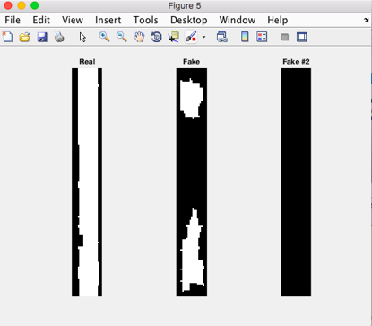
%Post processing on images using morphological closing operation using %'square' strel.
[BWImageCloseReal,BWImageCloseFake,BWImageCloseFake2] = postProcessOnImages(areaopenReal, areaopenFake, areaopenFake2);
Performing Morphological Operations

Slide 14
% //Count the total number of objects in this strip
[~,countReal] = bwlabel(BWImageCloseReal);
[~,countFake] = bwlabel(BWImageCloseFake);
[~,countFake2] = bwlabel(BWImageCloseFake2);
%Display Number of objects for real and fake notes
disp(['The total number of black lines for the real note is: ' num2str(countReal)]);
disp(['The total number of black lines for the fake note is: ' num2str(countFake)]);
disp(['The total number of black lines for the second fake note is: ' num2str(countFake2)]);

Slide 15
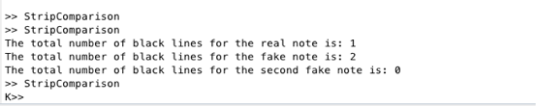
OUTPUT:
Explanation:
*As we can observe there are three currency notes in which there is a real note and two of them are fake.
*As we move further we come to know the note real has a strip, note fake too has a strip but with a discontinuity it and note fake#2 has no strip.
*The first operation that we perform is covering rgb2grayscale.
*Then for each image we are applying threshold intensity unto 30.
*The next step is to clarify the images by using open and reopen operations thus by removing the connected components.
*In this step we apply morphological operation :
SE = strel(‘square’,5): creates a square structuring element whose width is 5 pixels.

Slide 16

PART-2 (EDGE DETECTION)
Edge detection includes a variety of mathematical methods that aim at identifying points in a digital image at which the image brightness changes sharply or, more formally, has discontinuities. The points at which image brightness changes sharply are typically organized into a set of curved line segments termed edges. The same problem of finding discontinuities in one-dimensional signals is known as step detection and the problem of finding signal discontinuities over time is known as change detection.
Edge detection is a fundamental tool in image processing, machine vision and computer vision, particularly in the areas of feature detection and feature extraction.

Slide 17
CODE FOR EDGE DETECTION
clear;clc;
I = imread('origin3.jpg');
J = imread('origin4.jpg');
K = imread('fake3.jpg');
%Resizing the images
I=imresize(I,[301 720]);
J=imresize(J,[301 720]);
K=imresize(K,[301 720]);
figure(1);
imshow(I)

Slide 18
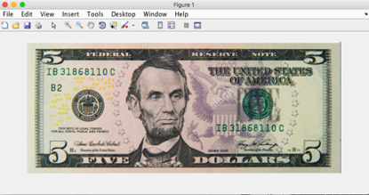
Original Image 1
figure(2);
imshow(J);

Slide 19
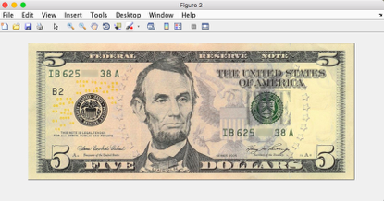
Real Image 2
figure(3);
imshow(K);

Slide 20
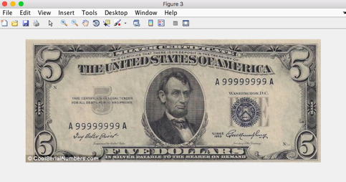
Fake Note Image
I = rgb2gray(I);
edge1 = edge(I,'canny');

Slide 21
J = rgb2gray(J);
edge2 = edge(J,'canny');
K = rgb2gray(K);
edge3 = edge(K,'canny');
figure(4);
imshow(edge1);
figure(5);
imshow(edge2);
figure(6);
imshow(edge3);

Slide 22
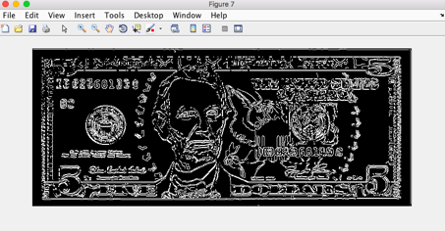
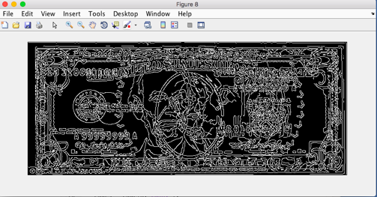
% Comparing two real canny edge images
figure(7);
imshowpair(edge1,edge2,'diff')
% Comparing real and fake canny edge images
figure(8);
imshowpair(edge1,edge3,'diff')

Slide 23
Explanation:
*In this program there are two real notes with different serial number and a fake note . Then we rearrange them in same size and perform rgb2gray scale operation.
*This program we are using edge detection operation by using canny method.
BW= edge(I,'Canny') detect edges using the Canny method. The Canny method finds edges by looking for local maxima of the gradient of I. The edge function calculates the gradient using the derivative of a Gaussian filter. This method uses two thresholds to detect strong and weak edges, including weak edges in the output if they are connected to strong edges. By using two thresholds, the Canny method is less likely than the other methods to be fooled by noise, and more likely to detect true weak edges.The Canny method is not supported on a GPU.
The second last step we can see that when two real images are compared there are minute differences but in the last step as we compare the real note with fake we can observe many differences.
Thus this is one of the best fake currency detection method.

Slide 24
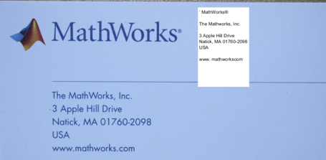
PART-3 (FEATURE DETECTION)
Local features and their descriptors are the building blocks of many computer vision algorithms. Their applications include image registration, object detection and classification, tracking, and motion estimation. These algorithms use local features to better handle scale changes, rotation, and occlusion.
In our programming we are going to use one the tool of feature detection i.e., OCR
Optical Character Recognition (OCR)
* Recognizing text in images is a common task performed in computer vision applications. For example, you can capture video from a moving vehicle to alert a driver about a road sign. Segmenting out the text from a cluttered scene helps with related tasks such as optical character recognition (OCR).
*The aim of Optical Character Recognition is to classify optical patterns (often contained in a digital image) corresponding to alphanumeric or other characters. The process of OCR involves several steps including segmentation, feature extraction, and classification.

Slide 25
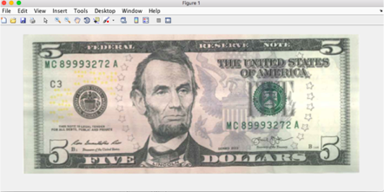
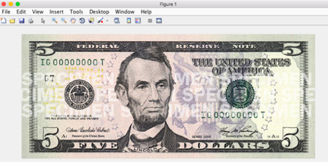
CODE FOR FEATURE DETECTION
% Load an image
origin = imread(‘origin.jpg');
imshow(origin);
fake = imread(‘fake.jpg');
imshow(fake);

Slide 26
I1 = imcrop(origin,[75 100 340 40]);
I2 = imcrop(fake,[40 58 250 40]);
% Perform OCR
i1Results = ocr(I1);
i2Results = ocr(I2);
% Display one of the recognized words
word = i1Results.Words{2}
word = i2Results.Words{2}

Slide 27
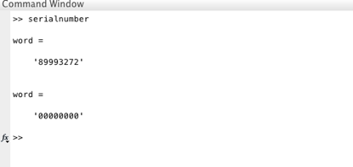
OUTPUT:
Explanation:
*In this program we are taking an real note and a duplicate note and performing OCR operation
*Then we have coped serial number portion of image
*Then we have applied OCR library to convert currency serial number into textual format.
*This textual serial number can be validated in data base.

Slide 28

CONCLUSION & FUTURE SCOPE:
*The above solution can be accompanied with currency detection algorithm.This project is an effort to suggest an approach for extracting characteristic of US dollar currency.
*Approach suggested from the beginning of image acquisition to converting it to gray scale image and up to the word segmentation has been stated.
*The work will surely be very useful for minimizing the counterfeit currency.
*In Future, Mobile app can be developed which would be useful for normal as well as visually impaired persons, the same system can be developed for the remaining Indian currency notes and other country’s currency notes. *Also the app’s interface can be further modified as per the user requirements.

Slide 29
REFERENCES
1)Jae-Kang Lee and Hwan Kim,“New Recognition Algorithm for Various Kinds of Euro Banknotes” 0-7803-7906-3/03/
2003 IEEE.
2)D.Alekhya, G.DeviSuryaPrabha and G.VenkataDurgaRao, “Fake Currency Detection Using Image Processing and Other Standard Methods”
3)H.Hassanpouri, A.Yaseri, G.Ardeshiri, “Feature Extraction for Paper Currency Recognition” 1-4244-0779-6/07/2007
IEEE.
4)https://en.wikipedia.org/wiki/Canny_edge_detector#Process_of_Canny_edge_detection_algorithm
5) https://www.mathworks.com/help/vision/optical-character-recognition-ocr.html

Slide 30


